Slide 1
Rockbuster Streaming Services:
Data Driven Insights to Support an Online Launch
Whitney Hardy
October 2025

Slide 2
Project Overview:
Rockbuster Stealth LLC is a movie rental company that used to have stores around the world. However, the movie rental business has changed from in store to streaming. To stay competitive the Rockbuster Stealth management team is planning to use its existing movie licenses to launch an online video rental service.
As the Business Intelligence team, we analyzed Rockbuster’s rental and customer data to provide data-driven insights to review and produced recommendations for the company’s launch strategy.

Slide 3
Key Business Questions:
What was the average rental duration for all videos?
Which movies contributed the most/least to revenue gain?
Which countries are Rockbuster customers based in?
Do sales figures vary between geographic regions?
Where are customers with a high lifetime value based?
These questions will provide critical insights into customer behavior and content performance as we transition to streaming. Using SQL for data extraction and Tableau for visualization, I will analyze rental patterns, revenue drivers, and geographic distribution of our customer base to make data-driven decisions about content acquisition, pricing strategies, and regional rollout priorities. This analysis will help us identify our most valuable customer segments and optimize our streaming platform to meet their preferences while maximizing revenue potential

Slide 4
Key Rental Metrics Overview
Average
Minimum
Maximum
Rental Duration: 4.98 days
Rental Rate: $2.98
Replacement cost: $19.98
Film Length: 115.27 minutes
Average 5-day rental duration aligns with typical viewing habits, providing a data-driven foundation for late fee policies and promotional offers
Rental Duration: 3 days
Rental Rate: $0.99
Replacement cost: $9.99
Film Length: 46 minutes
Rental Duration: 7 days
Rental Rate: $4.99
Replacement cost: $29.99
Film Length: 185 minute

Slide 5
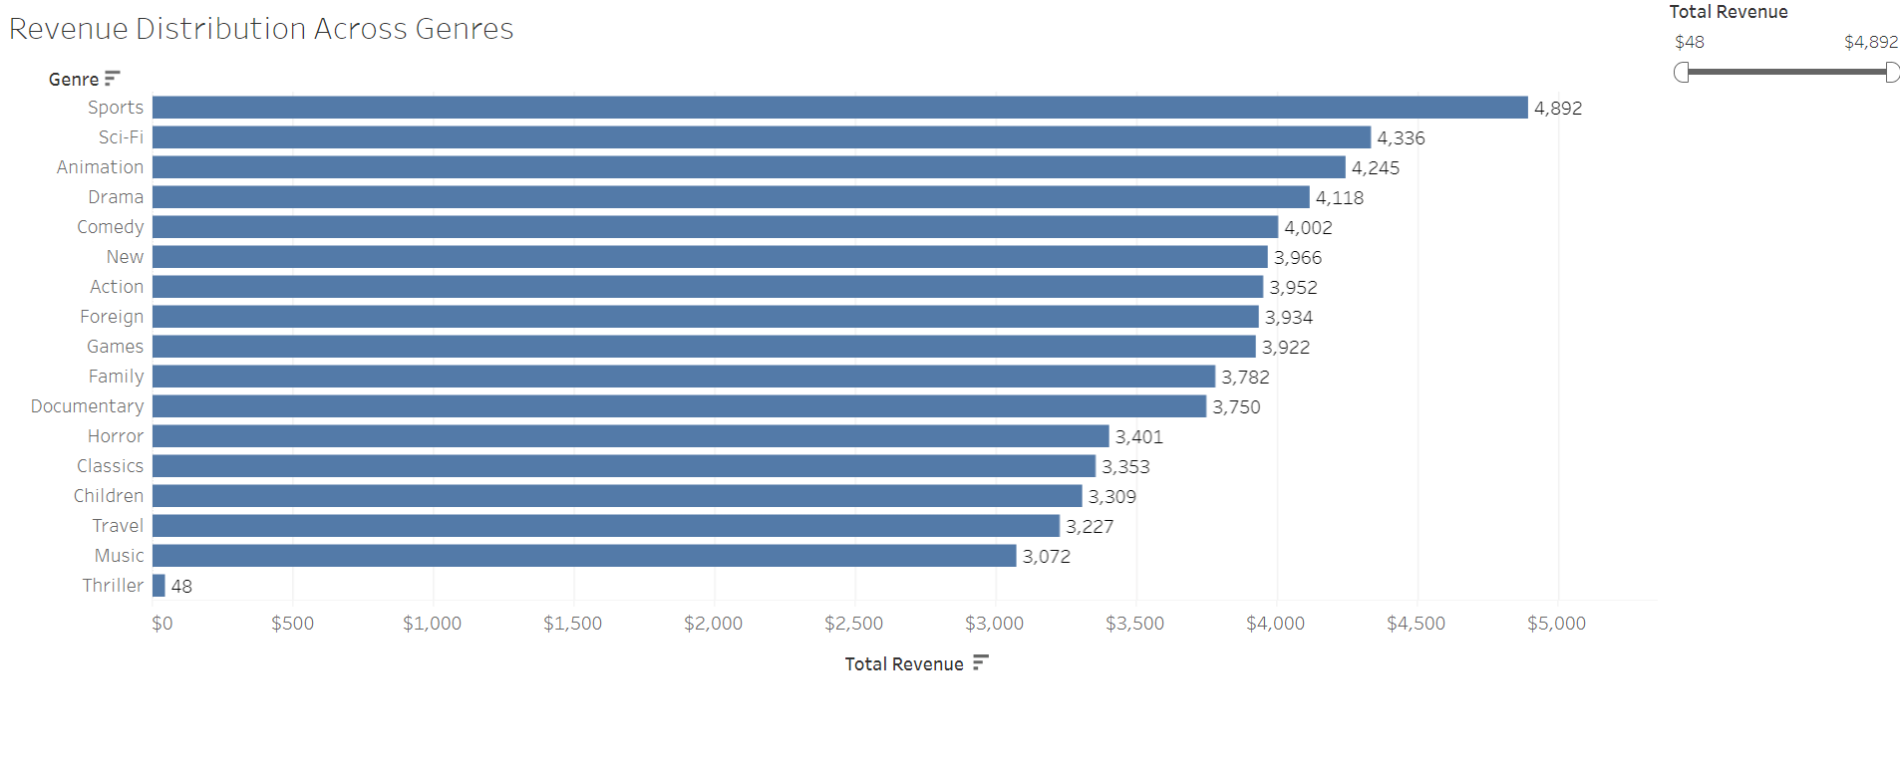
Which movies contributed the most/least to revenue gain?
Let's look at Genres:
The top 3 genres (Sports, Sci-Fi, Animation) collectively represent a substantial portion of total revenue.
There's a dramatic gap between the highest (Sports: $4,892) and lowest (Thriller: $48) revenue generators—over 100x difference

Slide 6
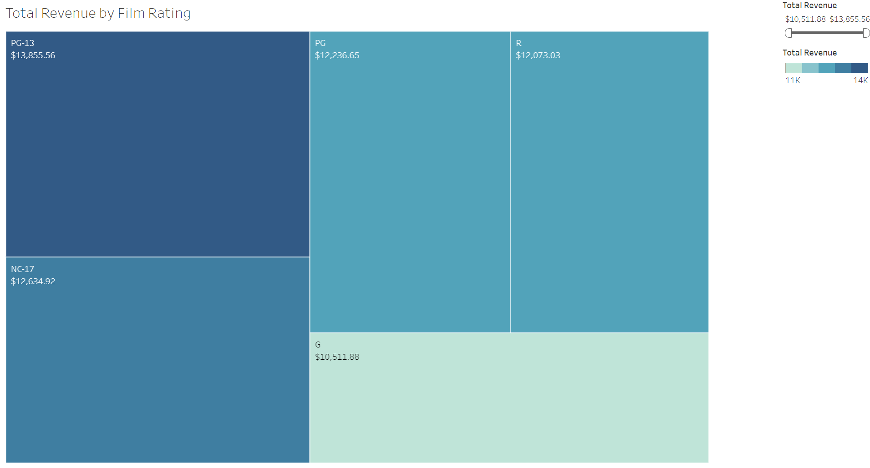
Which movies contributed the most/least to revenue gain?
Let's look at Ratings:
PG-13 films generated the highest revenue at $13,855.56, making it the most profitable rating category
The revenue spread across ratings is relatively balanced, with only about a $3,344 difference between the highest and lowest performers
PG-13 dominates by capturing the broadest audience demographic (teens and adults)

Slide 7
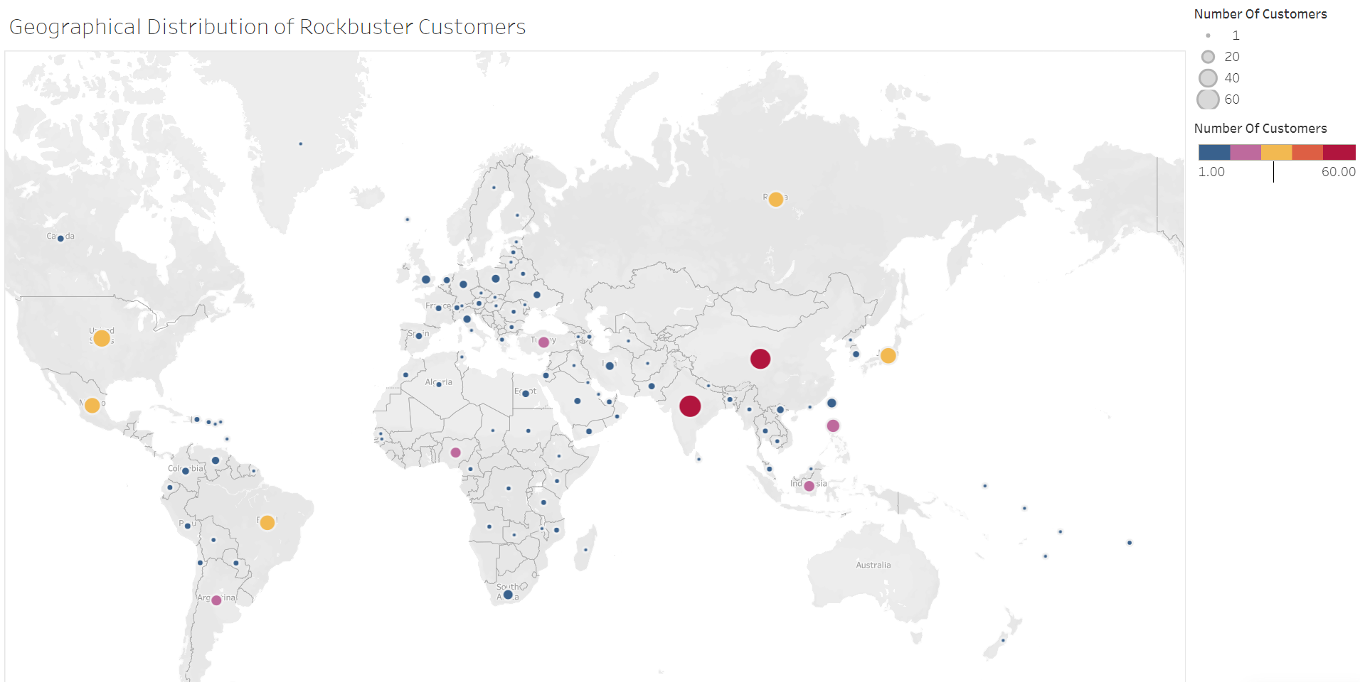
Where are Rockbuster customer located?
There are currently 599 customers located in 108 countries.
Geographic presence is widespread but uneven, with notable concentrations in North America, Europe, and Asia, while Africa and Australia remain largely untapped markets with growth potential

Slide 8
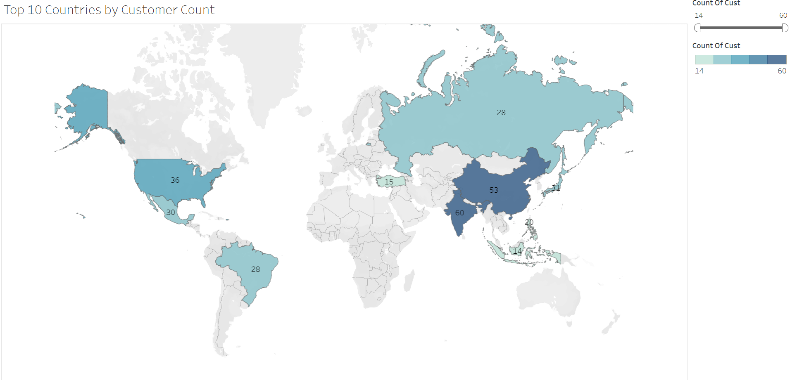
Do sales figures vary between geographic regions?
A look at the top 10 Counties
India (60) and China (53) dominate the customer base, accounting for the two largest markets.
Strong presence across diverse regions including North America (US: 36, Mexico: 30), South America (Brazil: 28), and Russia (28), demonstrating successful international market penetration.

Slide 9
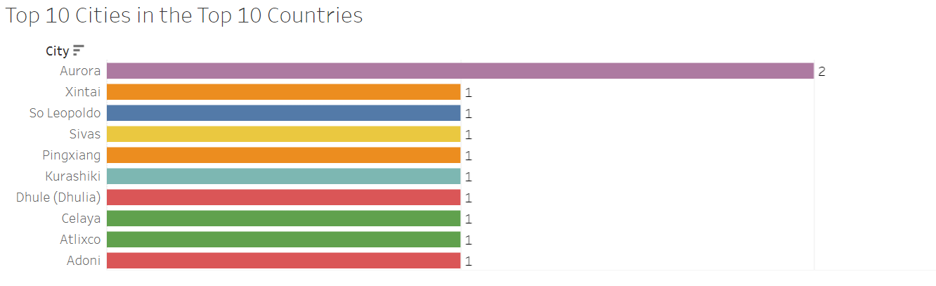
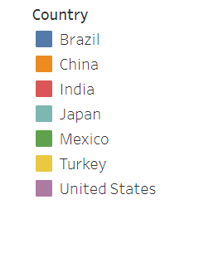
Top 10 Cities within the Top 10
Customer distribution is remarkably even.
Aurora, USA is the only city with two customers
All other top cities have exactly 1 customer each
India, China, and Mexico each have 2 cities represented in the top 10, indicating broader geographic penetration within these countries

Slide 10
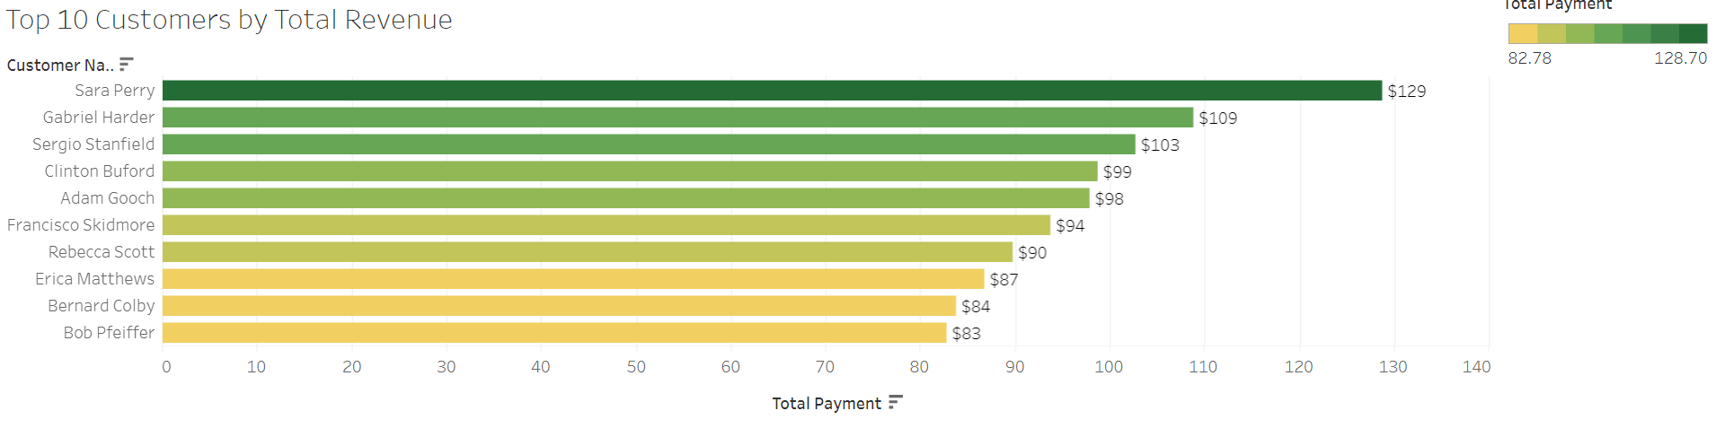
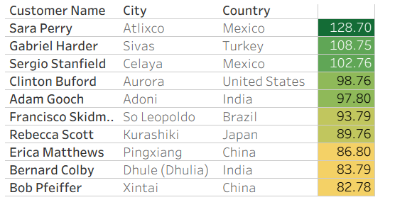
Top Paying Customers
Top three customers are geographically diverse
Revenue concentration is relatively tight: with only a $46 difference between top ten customers.

Slide 11
Strategic insights
Geographic Market:
Customer base spans 108 countries with 599 total customers, demonstrating strong international reach.
India and China represent the two largest markets with significant growth potential
North America, Europe, and Asia show established presence, while Africa and Australia remain largely untapped markets with substantial expansion opportunities
Top 10 countries show diverse geographic distribution across continents, indicating successful international market penetration
Revenue Drivers:
Sports, Sci-Fi, and Animation genres are the clear revenue leaders, collectively generating the majority of total revenue.
PG-13 rated films dominate revenue, capturing the broadest audience demographic of teens and adults.
Rating Performance:
Revenue distribution across rating categories is relatively balanced, with only a $3,344 difference between highest and lowest performers
PG-13's dominance suggests family-friendly content with broad appeal drives the most engagement and profitability

Slide 12
Recommendations
Content Strategy:
Prioritize high-performing genres: Invest heavily in Sports, Sci-Fi, and Animation content for the streaming library, as these genres have proven revenue generation capability.
Focus on PG-13 content: Build a robust catalog of PG-13 rated films and shows to capture the broadest possible audience
Evaluate underperforming genres: Consider strategic reduction or reimagining of Thriller content, or identify niche opportunities to improve performance
Geographic Expansion Strategy:
Phase 1 - Strengthen existing markets: Launch streaming service first in India and China, leveraging the established customer base and market familiarity
Phase 2 - Expand to proven markets: Roll out to North America (US, Mexico), Russia, and Brazil where strong customer presence already exists
Phase 3 - Target growth markets: Develop strategic entry plans for Africa and Australia, which show minimal current penetration but represent significant untapped revenue potential
Performance Monitoring:
Establish KPIs tracking regional adoption rates, genre preferences by market, and revenue per customerUse SQL and Tableau dashboards to continuously monitor streaming metrics and adjust content strategyConduct A/B testing on content recommendations to optimize engagement across different rating categories and genres

Slide 13
Links:
Revenue by Genre: https://public.tableau.com/app/profile/whitney.hardy/viz/RevenuebyGenres/RevenuebyGenre?publish=yes
Revenue by Ratings: https://public.tableau.com/app/profile/whitney.hardy/viz/TotalRevenuebyFilmRating_17606518030170/Sheet1?publish=yes
Customers by Country: https://public.tableau.com/app/profile/whitney.hardy/viz/CustomersMap_17607245355670/CustomersMap?publish=yes
Top 10 countries: https://public.tableau.com/app/profile/whitney.hardy/viz/Top10CountriesbyCustomerCount_17607271281400/Sheet1?publish=yes
Top 10 Cities: https://public.tableau.com/app/profile/whitney.hardy/viz/TopCitiesinTopCountries_17607282149500/TopCitiesBarChart?publish=yes
Top Customers: https://public.tableau.com/app/profile/whitney.hardy/viz/Top10Customers_17607314176970/TopCustomerBar?publish=yes

Slide 14
Thank You For Your Time
Please reach out to whardy@rockbuster.com with ant further questions

